Slide 1
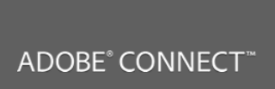


Welcome
Adobe Connect Basics

Slide 2
Adobe Connect Basics : What’s Covered?
Part 1
Meeting
Log in Get Help
Book License
Meeting or Event?
Create a Meeting
Create Event
Run Meeting Room

Slide 3
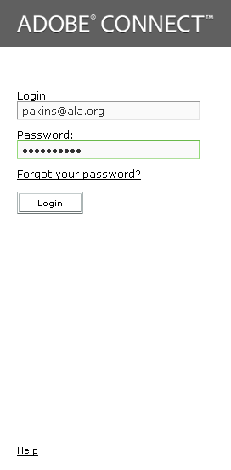
Adobe Connect: Log In
Log In/ Get Help
Part 1
Where is it?
ala.adobeconnect.com
What is it?
Remote meeting and Event tool used for demonstrations and online learning within ALA.
Replacement for iLinc. If you want to share iLinc content you will need to create an Event in Adobe Connect.
What are my Credentials?
Username: Your email address for ALA
Password: ALA website password, choose “Forgot My Password” to reset.
Please note the Help link on this screen, to the version 9 manual, video tutorials; and Adobe resources!

Slide 4
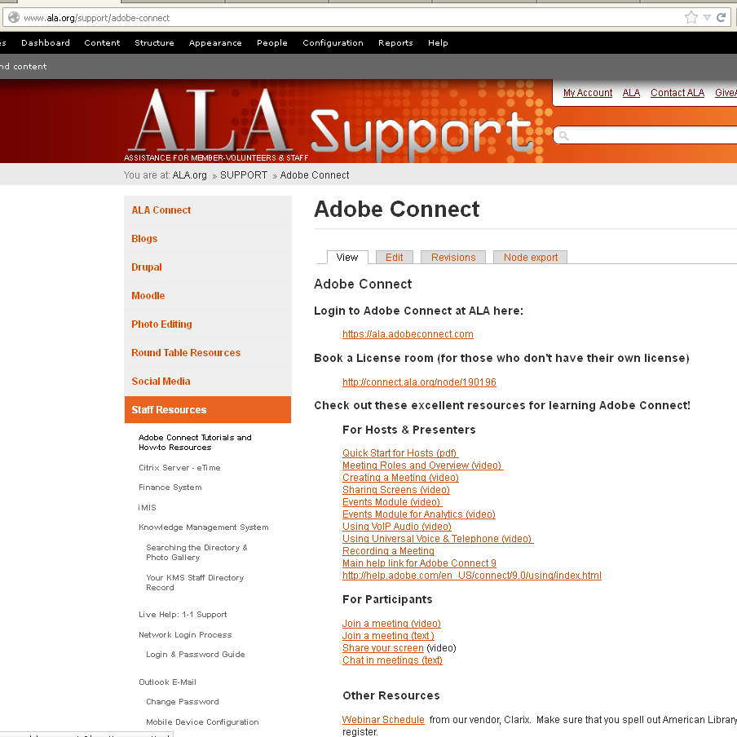
Adobe Connect: Get Help
Get Help
Part 1
Get Help
ala.org/support/adobe-connect
What is it?
Source of training resources and documentation for working with Adobe Connect at ALA
What are my Credentials?
Username: Your ALA website login
Password: ALA website password, choose “Forgot My Password” to reset.

Slide 5
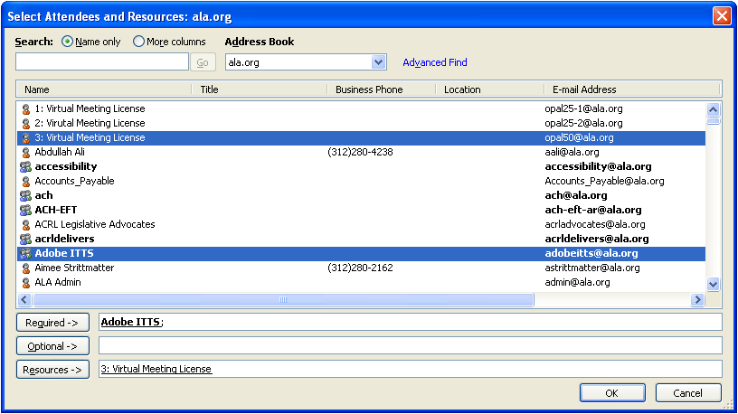
Adobe Connect Basics: Book License
Log In/ Get Help
Book License
Part 1
Use Outlook; include Adobe ITTS
Put the License in the RESOURCE field
Book Practice and setup time
This step not needed if you own a license

Slide 6
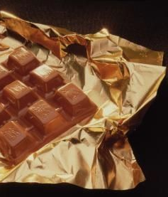
Meeting or Event?
An Event is a powerful wrapper around Live or On Demand Content.
Draws attractive attention to the content
Enables you to moderate registration, ask questions prior to approving (or denying) session entry
Provides detailed information
Gives date and time of when to access it
Controls when and who can access it
Makes it track-able for reports on usage, registration, participation and more.
On Demand (Pre-recorded) Content
Live Content: Meeting, Webinar
A Meeting is the content where Hosts and/or Presenters usually interact with participants in a meeting room.
Can be password protected
Can be recorded
Can accommodate participants (invite via email with link to participants)
Can connect to an Event

Slide 7
Steps to create a Meeting
You have a defined list of invitees
MACS may be handling the registration
No need to moderate registrants;
No automated email reminders
No microsite created
No custom invite including speaker details
No analytics or reporting on engagement req.
Create meeting
Set room access & session details
Send link to invite attendees
Run & Record?) Session
Great for smaller meetings or ones where no extra event features are needed.
You can still record
& take advantage of all the meeting room features of

Slide 8
Steps to create an Event
Wrap Event functionality around your Meeting if:
You are casting invitation to a more open audience
You need to moderate registrants; (approve, deny or waitlist)
You want automated invites, reminders &/or thank-yous
You want a web presence to promote the event
You want invite to include speaker details in layout
You need analytics or reporting on engagement req.
Use “Participant Management command to manage registration
Create Meeting
Create Event
Moderate Registration
Run Session
Add Event Details
Confirm Registration Questions
Link to Meeting
Select Email Options
Publish Event
Great for formal sessions taking advantage of Adobe’s features to:
promote the session
Ask registration questions
Provide detailed reports
and more.

Slide 9
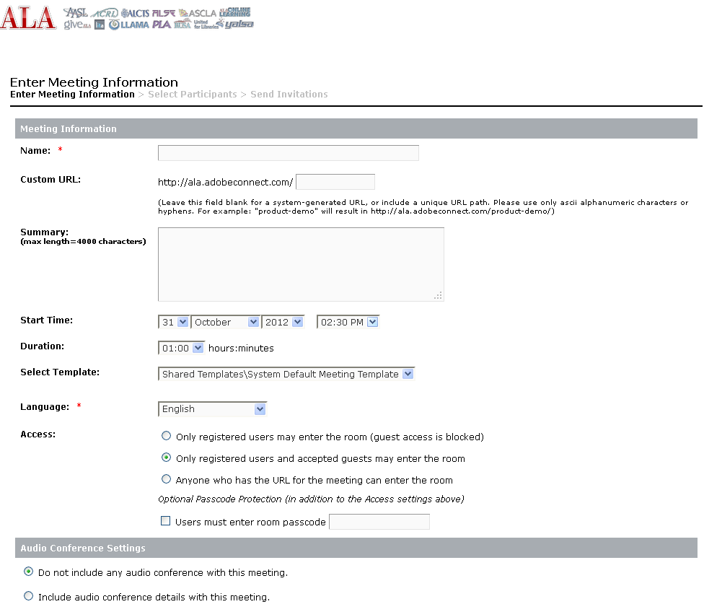
Adobe Connect: Make a Meeting
Log In/ Get Help
Book License
Make Meeting
Name of the Meeting. This is the only required field.
Part 1
Make a easy to type URL for attendees to use to come to the meeting.
This is an overview of what the session will be about.
Meetings are persistent—they are always available until you delete them. This date and time is used for invitations.
Login is required on the first two choices
Watch the Video:
http://tv.adobe.com/watch/learn-adobe-connect-8/creating-a-meeting/

Slide 10
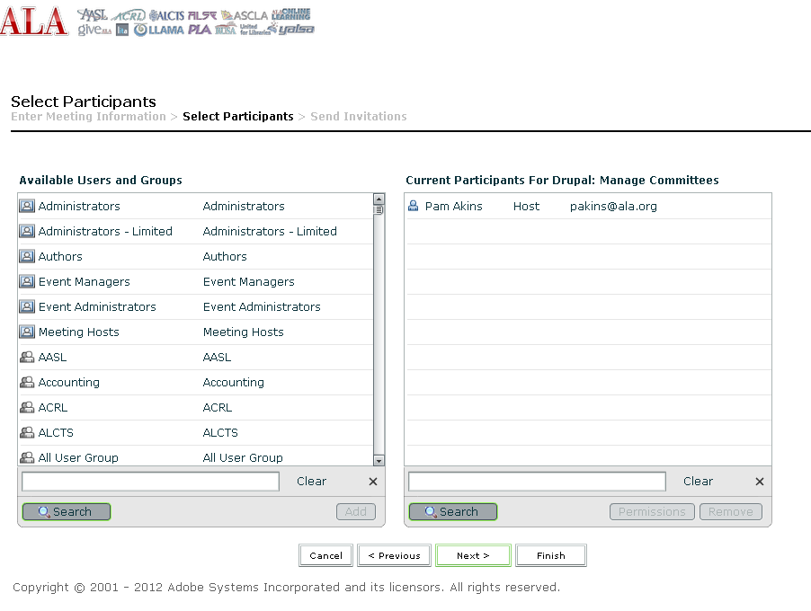
Adobe Connect : Invites
Log In/ Get Help
Invite
Book License
Make Meeting
You can invite people that are not in the available Users and Groups by emailing them the link on the NEXT screen.
It is ok not to select anyone from the internal list.
Part 1

Slide 11
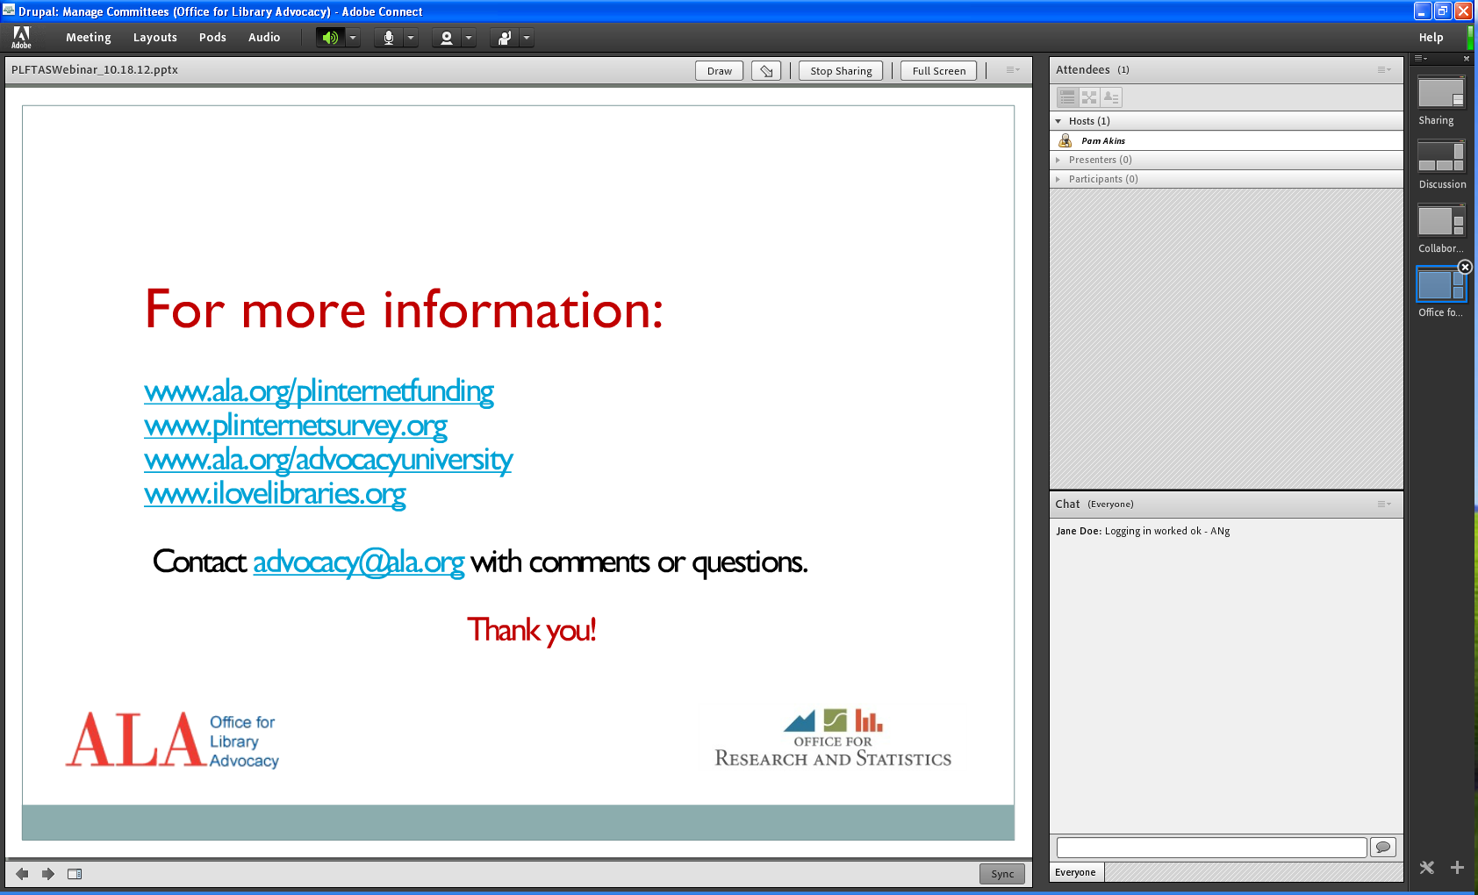
Adobe Connect : Preflight Check/Run Session
Log In Help
Book License
Make Meeting
Invite
Run Session
Part 1
You can change this meeting layout by choosing or any other one on the left (Under Meeting Layouts) and delete ones you don’t want.
Before your meeting, run the Audio wizard and check mic settings for your participants
You may need to clear the chat from the last meeting using the menu in the top right of the chat pod.

Slide 12
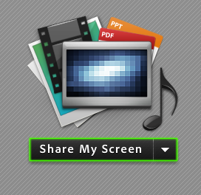
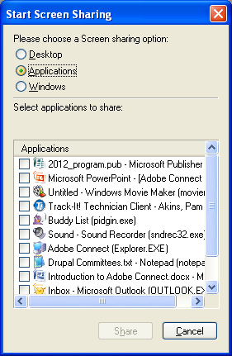
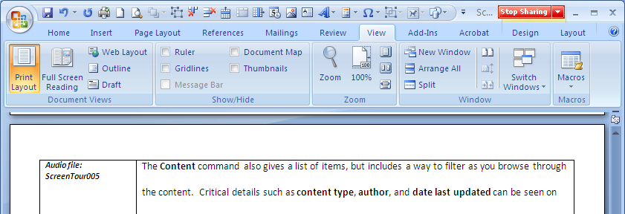
Adobe Connect : Run Session (Screen Sharing)
Log In Help
Book License
Make Meeting
Invite
Run Session
Part 1
1
2
3
You can open and edit documents while you are sharing. Make sure the document is open and not minimized so you can select it from the list.

Slide 13
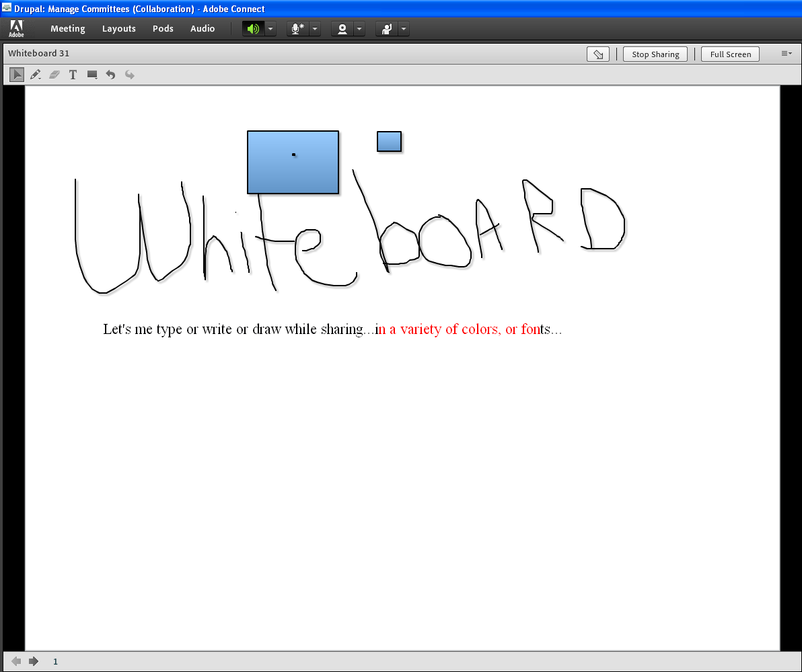
Adobe Connect : Run Session (Whiteboard Sharing)
Log In Help
Book License
Make Meeting
Invite
Run Session
Part 1
1
2
Sharing whiteboard, lets you capture notes that your attendees can see as you are typing, drawing or writing them out. It is great for collaboration especially if you have more than one presenter

Slide 14
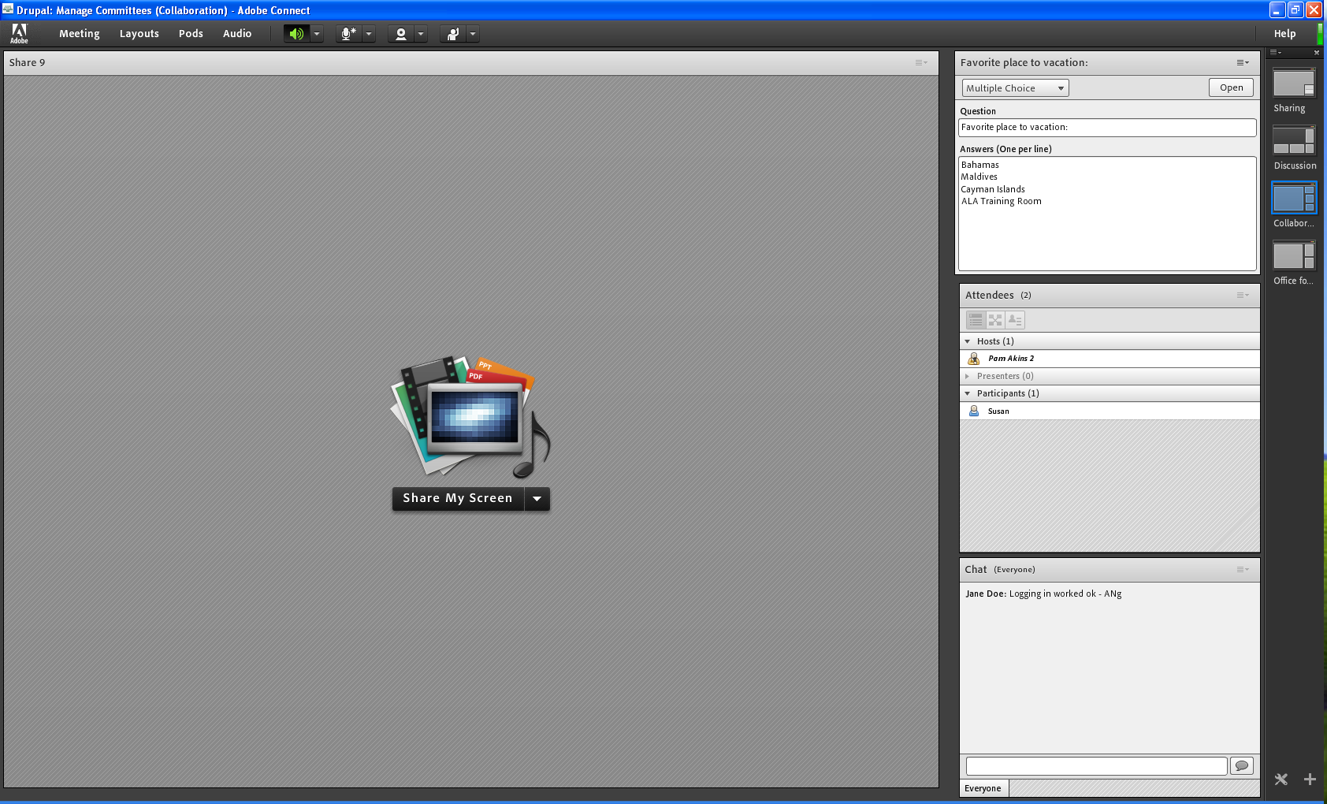
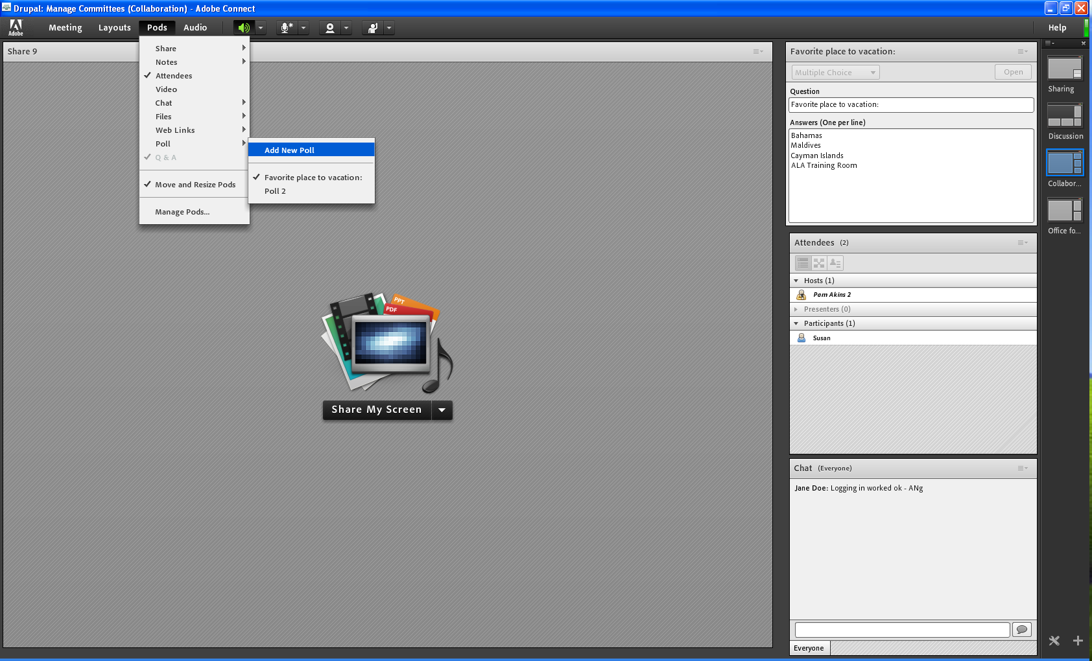
Adobe Connect : Run Session (Polls)
Log In Help
Book License
Make Meeting
Invite
Run Session
2
1
Part 1
Heighten attendee engagement during the session with the poll.

Slide 15
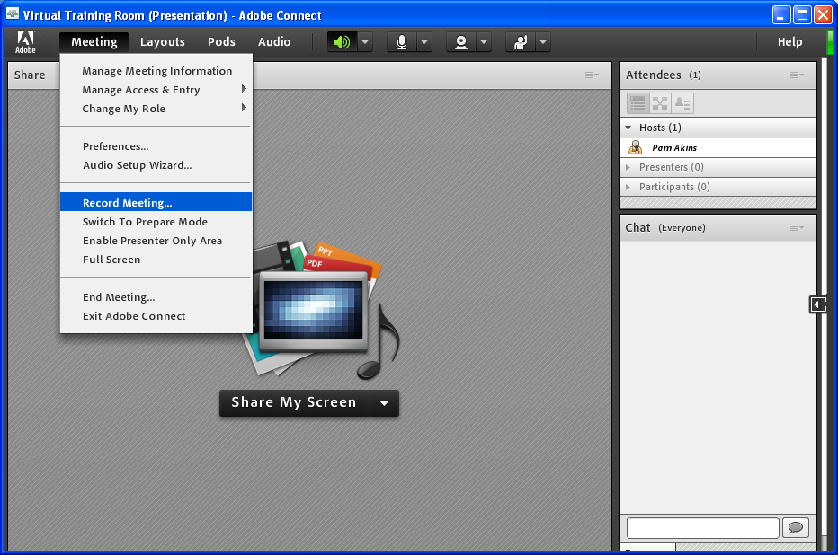

Slide 16
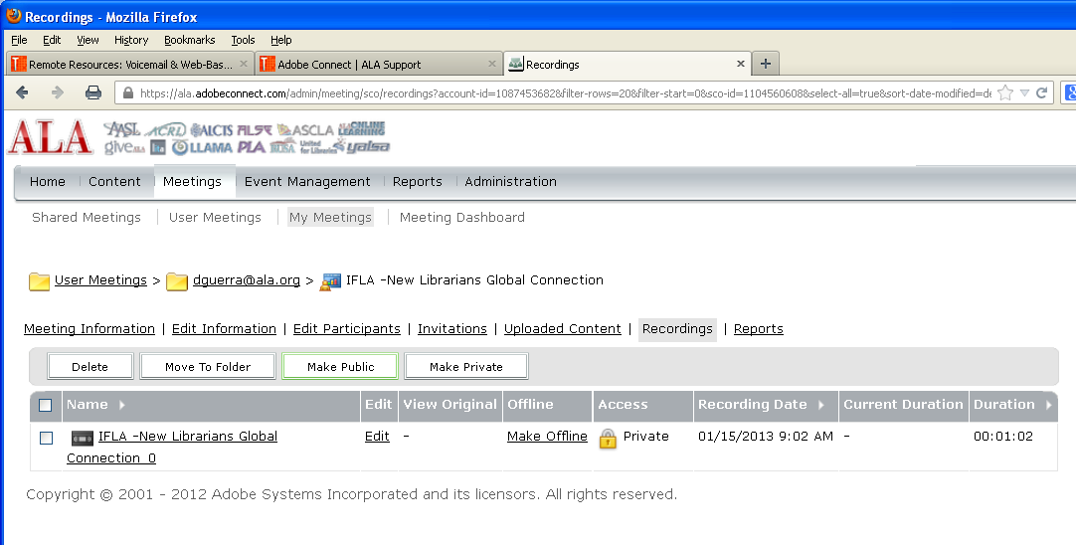
Post Meeting: Make Recordings Public

Slide 17
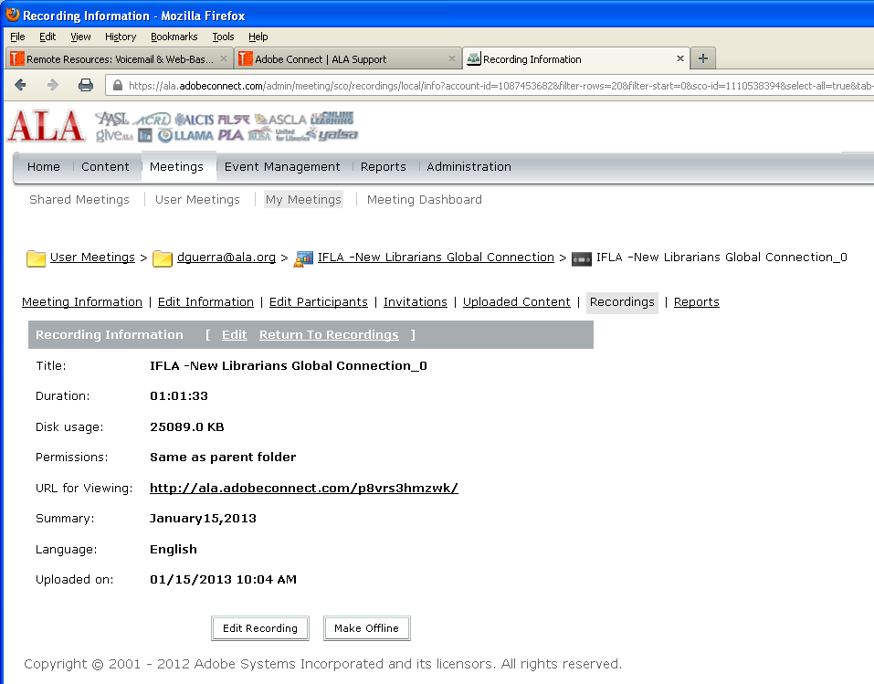
Send Out Recording Link

Slide 18
Adobe Connect Basics : What’s Covered?
Part 2
Meeting
Events vs Meetings
Setup Event
Invite & Register
Manage Content
Run Reports

Slide 19
Meeting or Event?
Events vs Mtgs
Part 2
An Event is a powerful wrapper around Live or On Demand Content.
Draw attractive attention to the content
Detail what the content is about
Provide detailed information about the content
Gives date and time of when to access the content
Control when and who can access the content
Summarize highlights of the content
Makes content track-able for reports on usage, registration, participation and more.
Enables options for notifying and getting info on interested/potential users of the content
On Demand (Pre-recorded) Content
Live Content: Meeting, Webinar
A Meeting is the content where Hosts and/or Presenters usually interact with participants in a meeting room.
The room can be password protected
It can be recorded
Link to the session can be sent via email to participants
Can connect to an Event

Slide 20
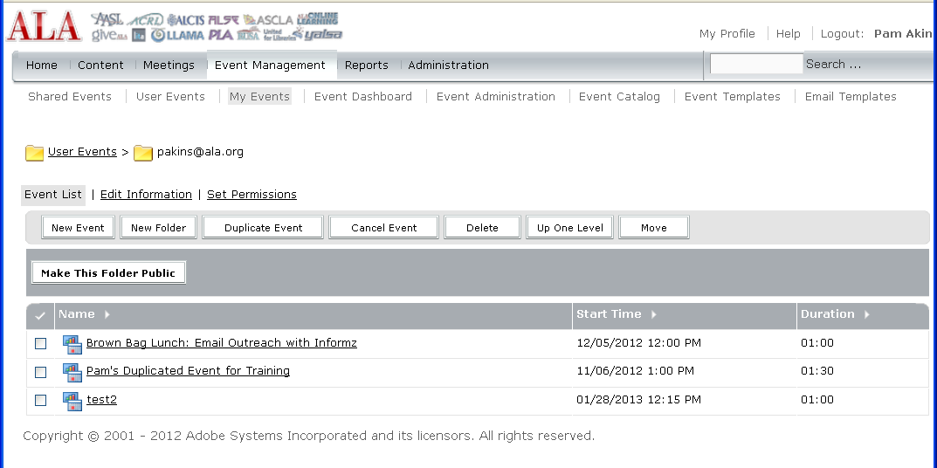
New Event
Add a New Event

Slide 21
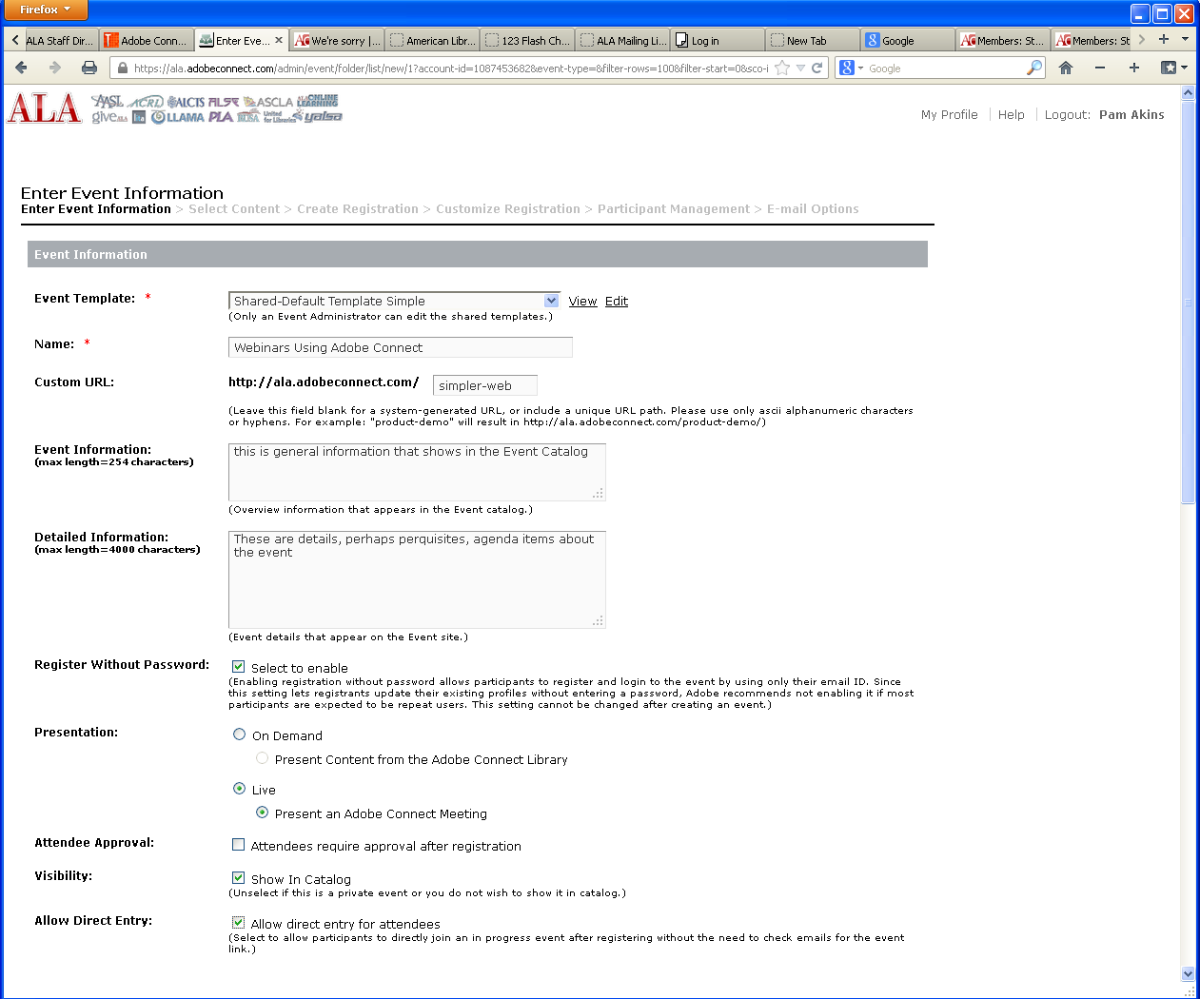
Create Event

Slide 22
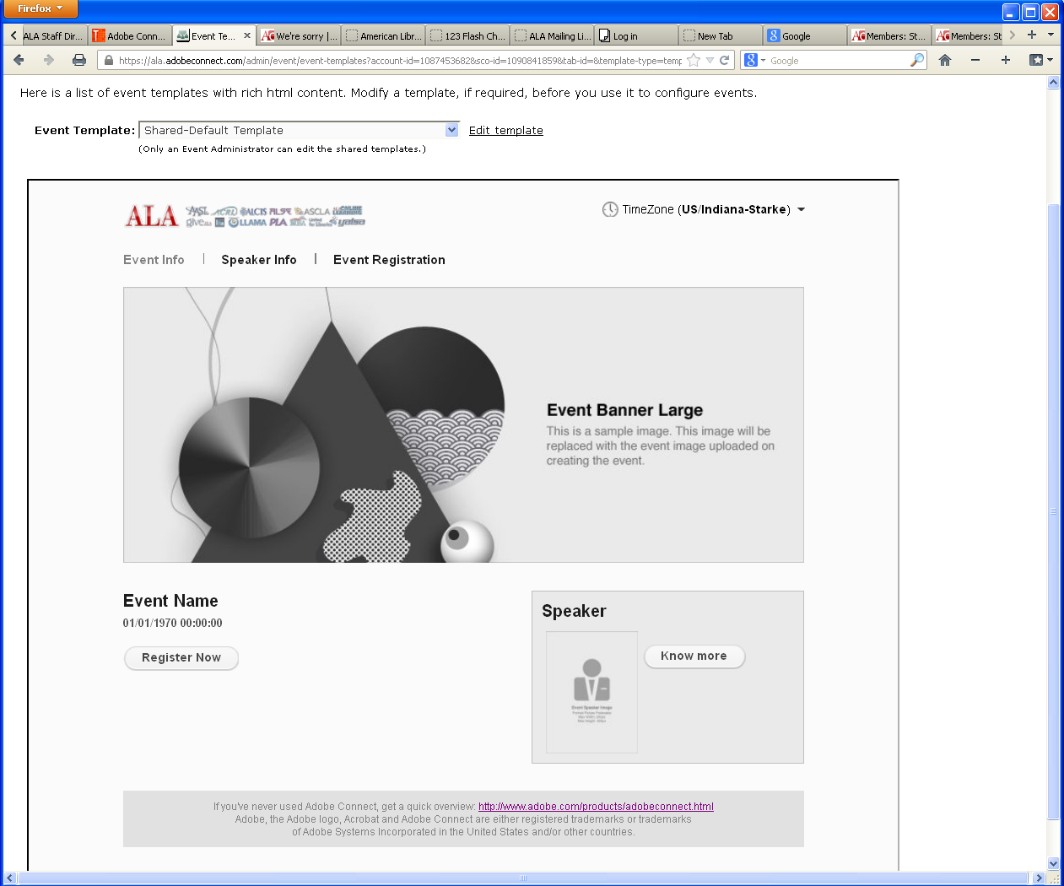
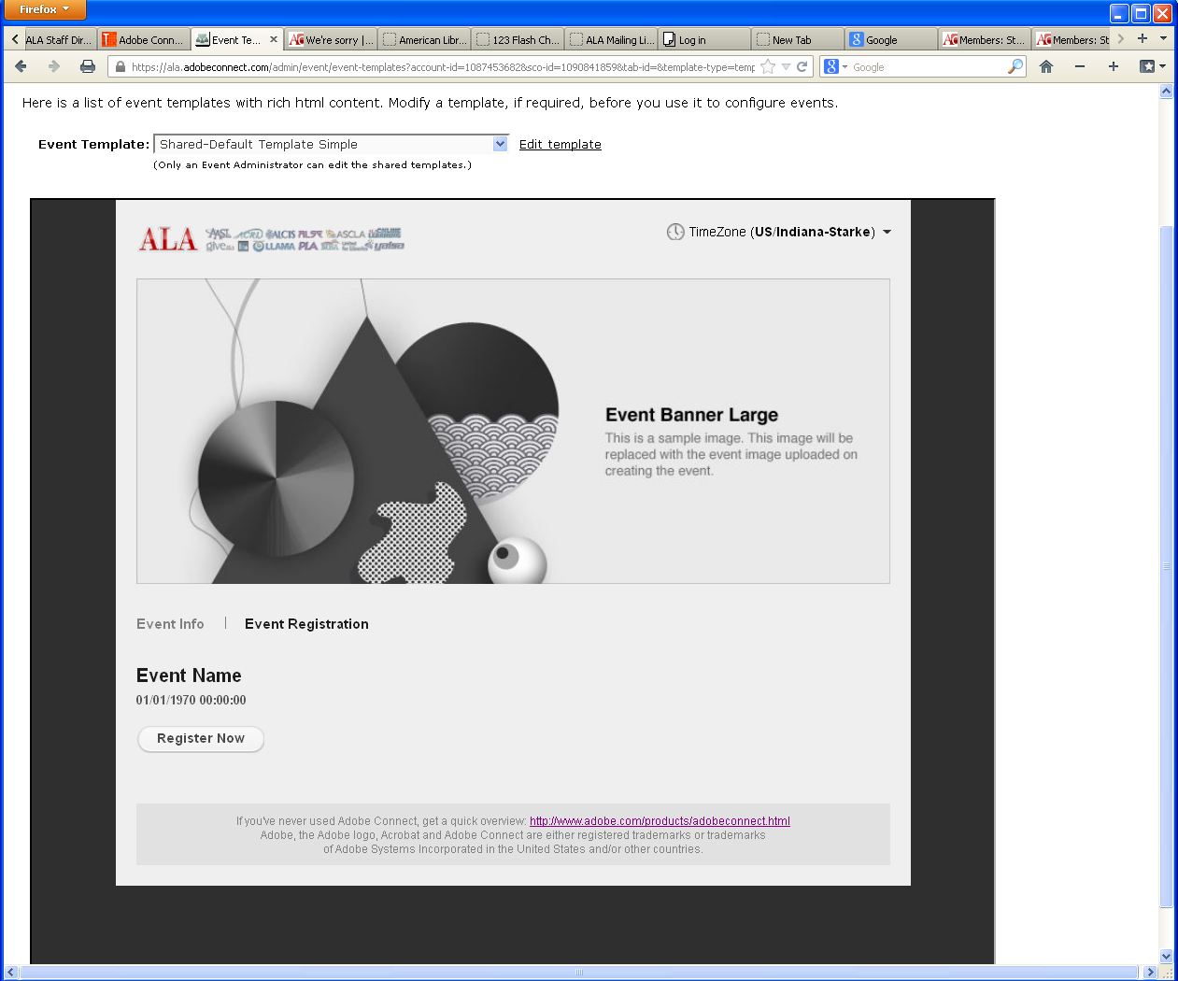
Event Templates
Shared-Default Template
Shared-Default Template Simple

Slide 23
Create Event
If most attendees do not have profiles in Adobe Connect, select this box

Slide 24
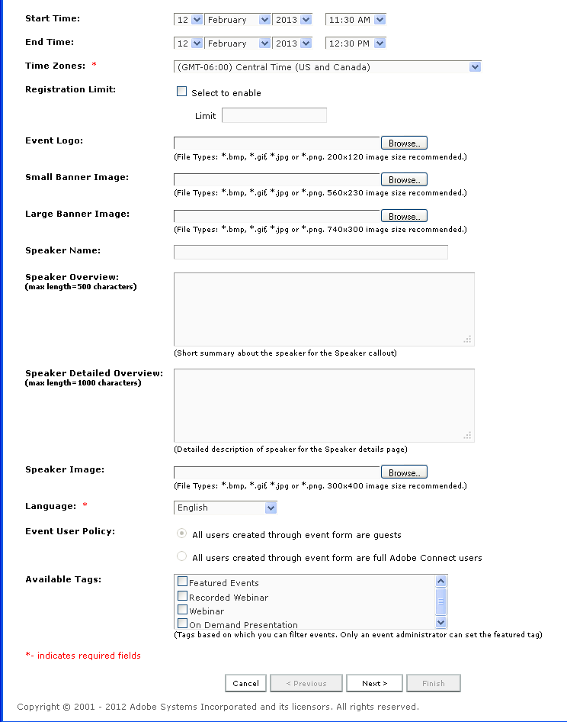
Event Information

Slide 25
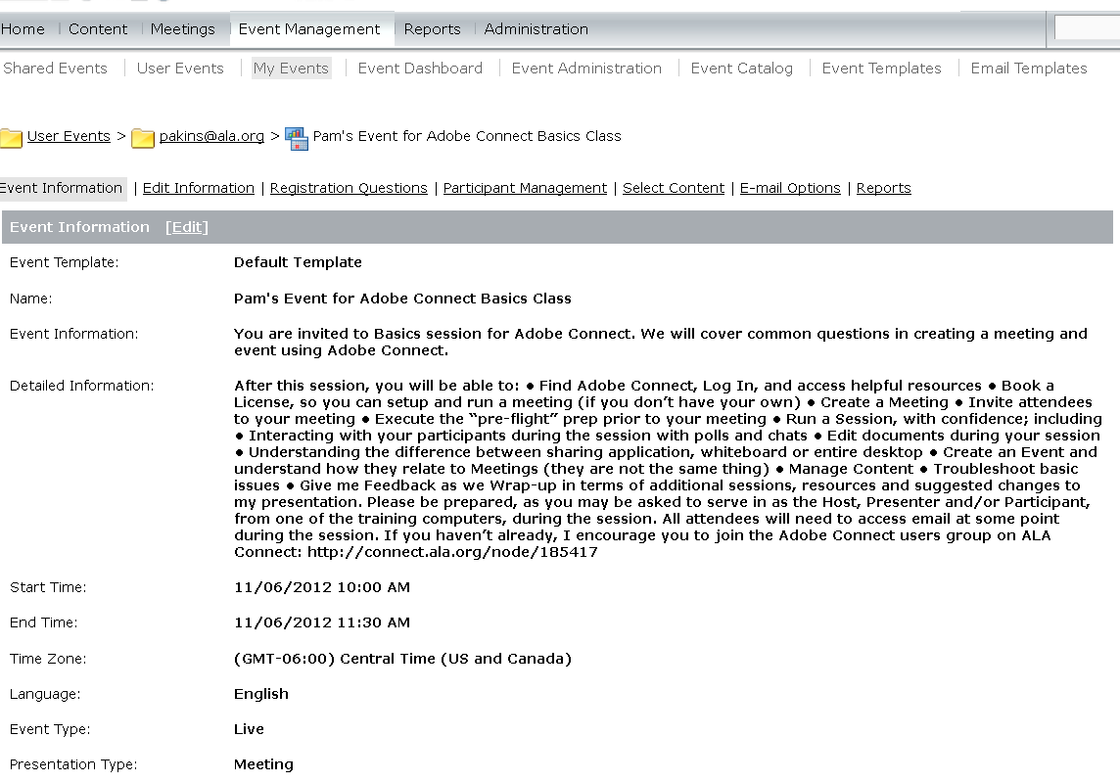
Event Setup
Event v. Meeting
Setup Event

Slide 26
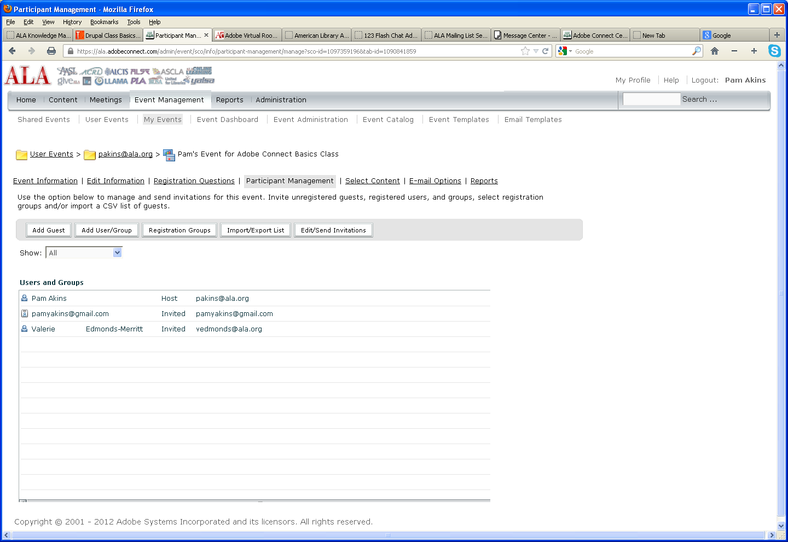
Manage Invites & Registration
Event v Meeting
Setup Event
Invite & Register

Slide 27
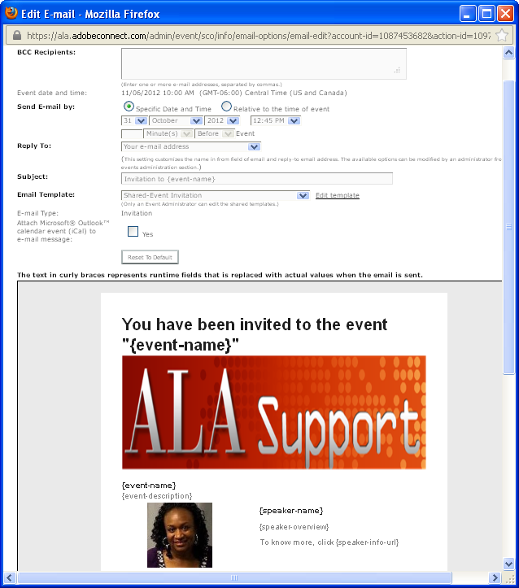
View Email template

Slide 28
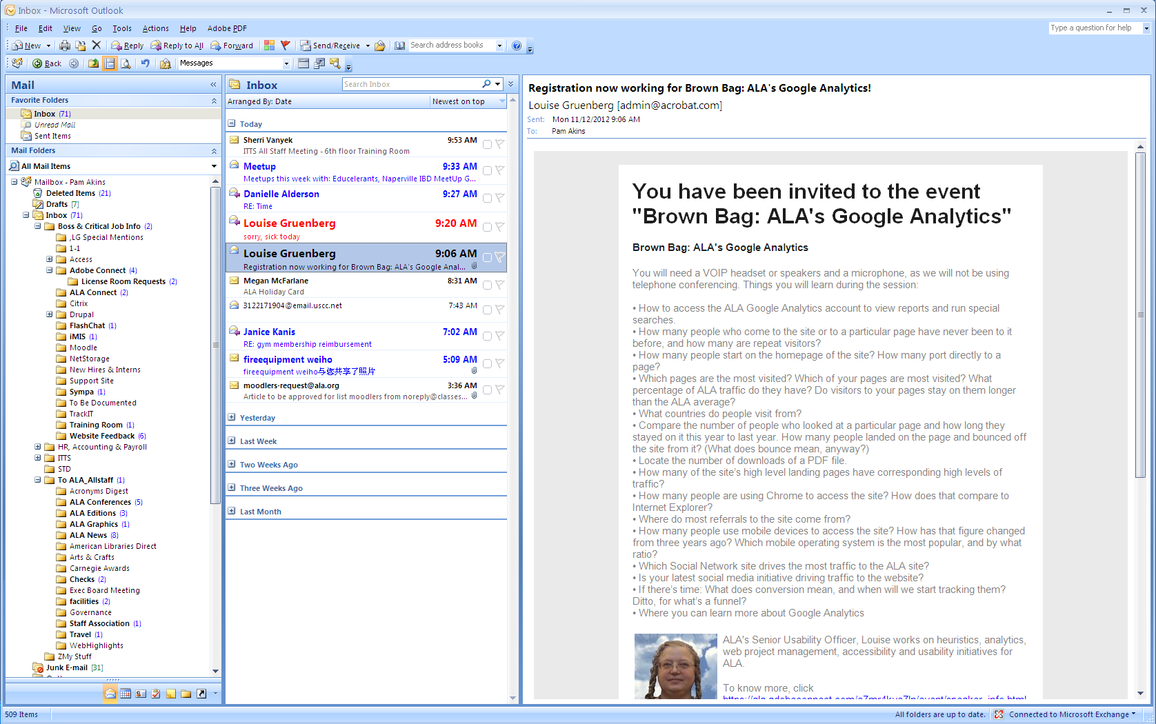
What Invitee Sees: Email

Slide 29
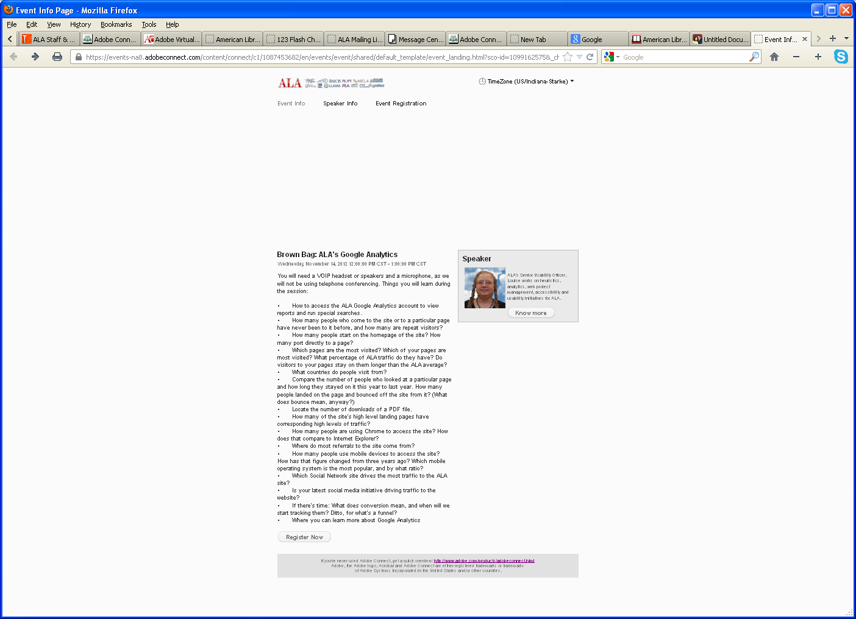
What Invitee Sees: Link to Invite on Site

Slide 30
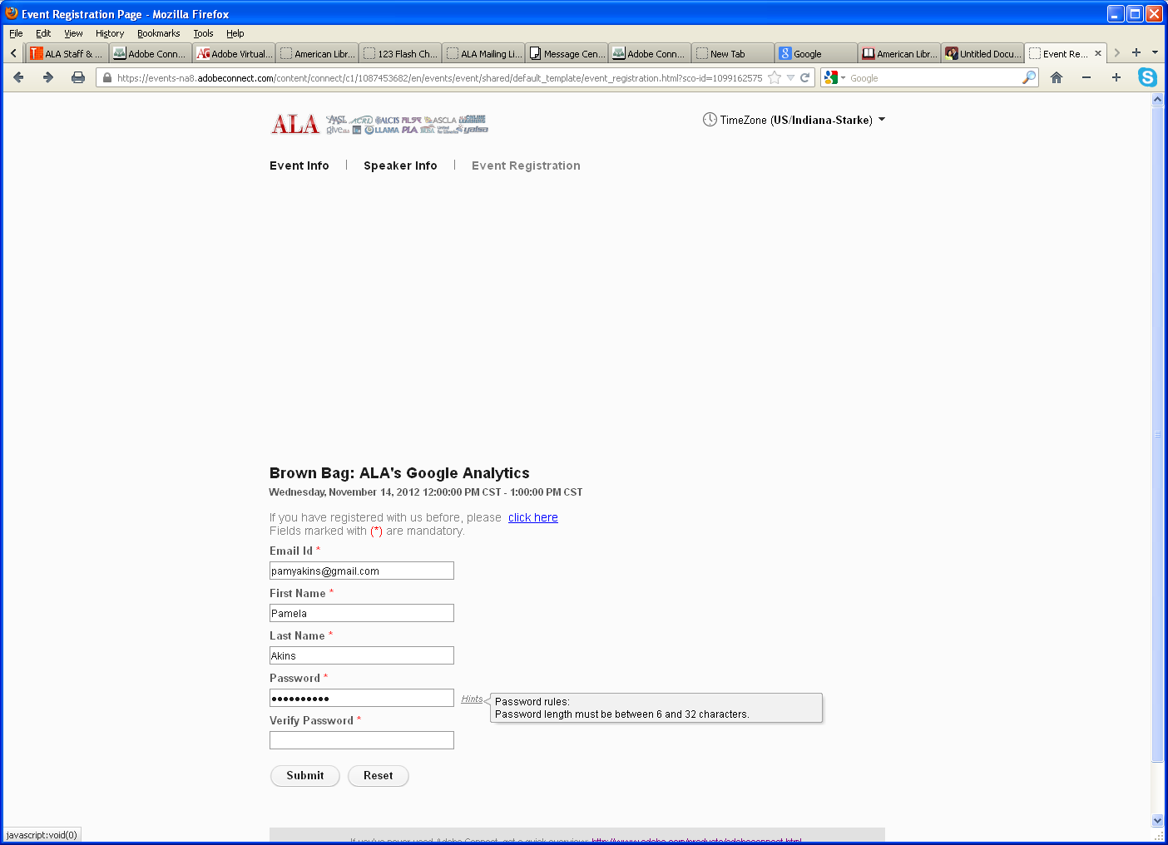
What They see if you hit REGISTER NOW
*With no image in field for Large Banner

Slide 31
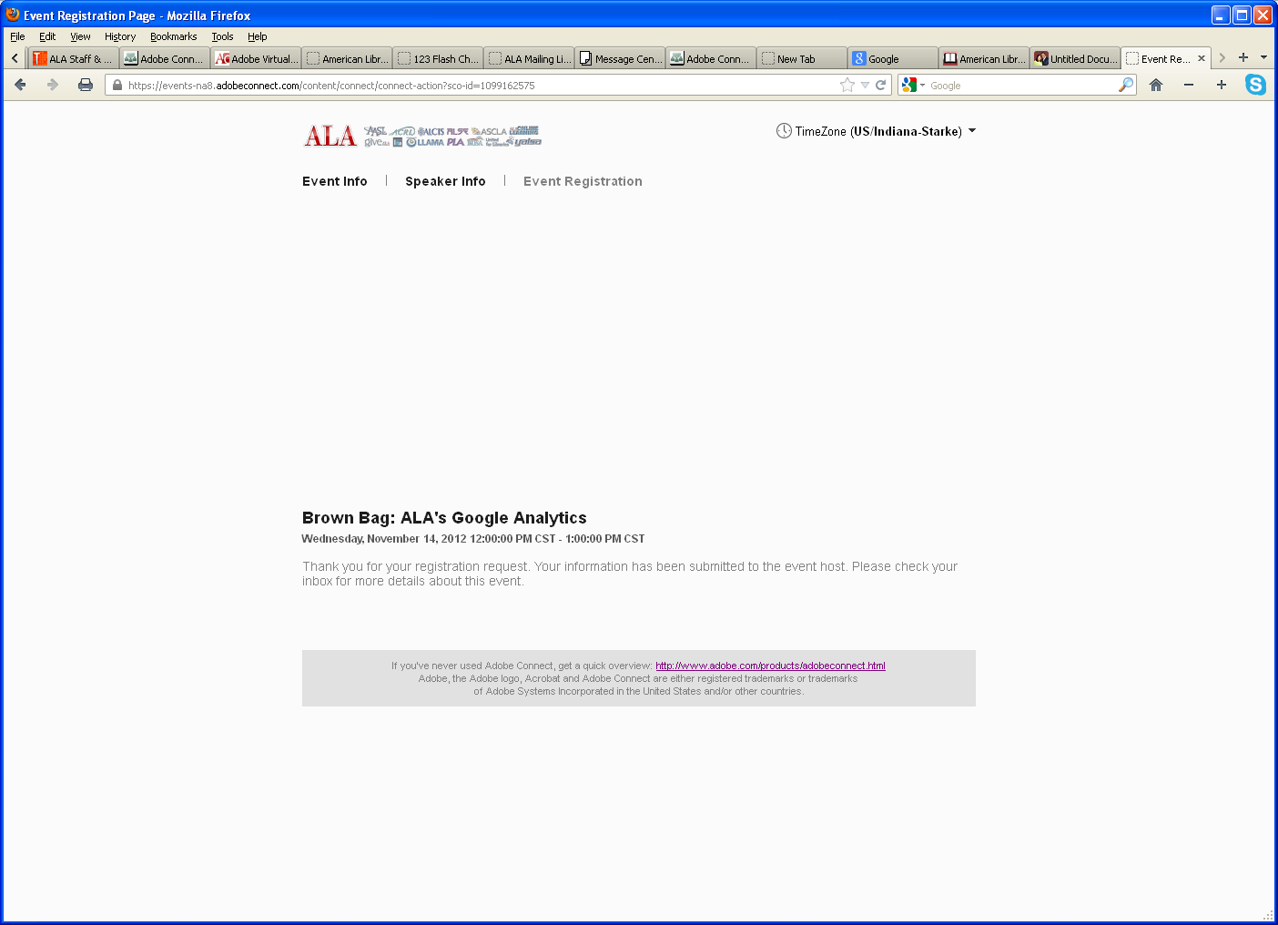
What they see when registration is successful

Slide 32
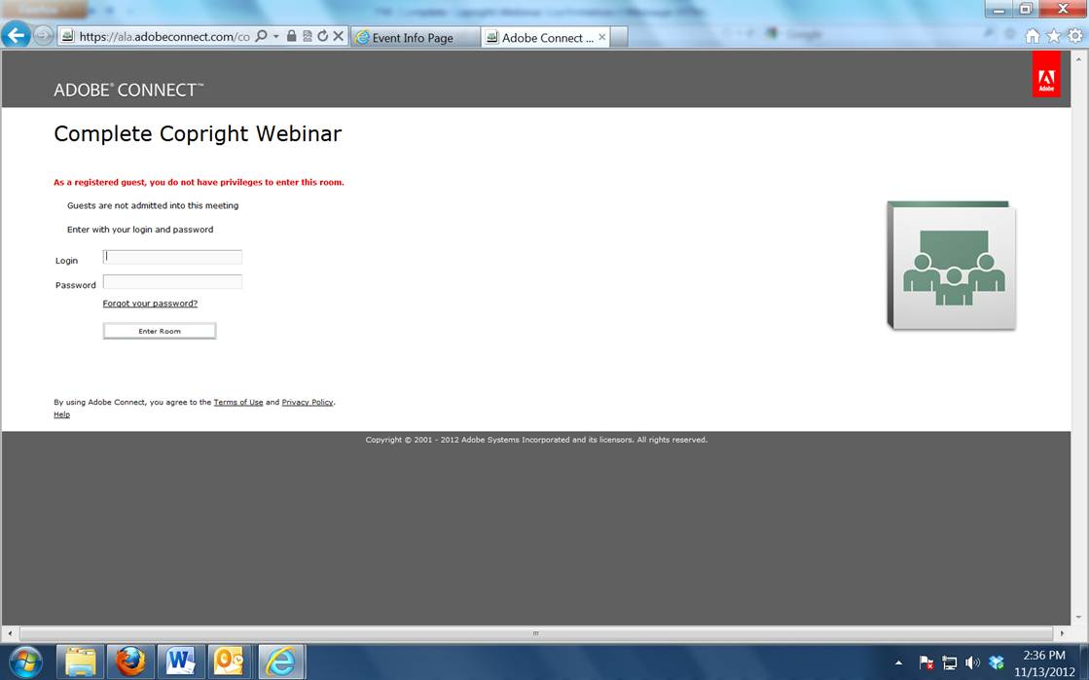
What they see if you don’t allow accepted guests into your meeting

Slide 33
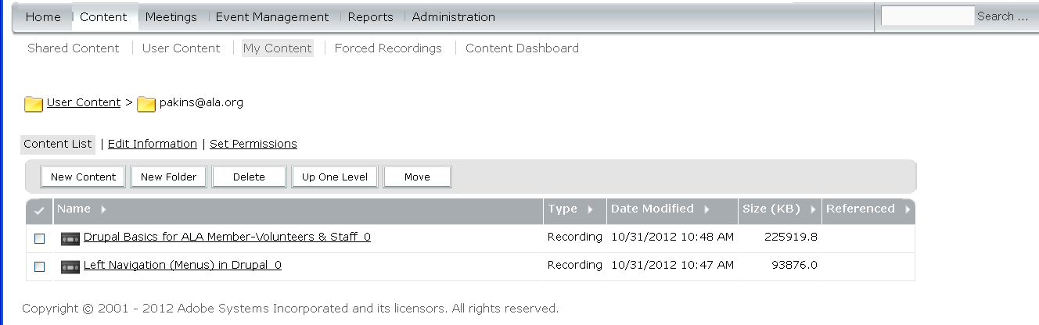
Manage Content
Event v. Mtg
Content & Reports
Setup Event
Invite & Register

Slide 34
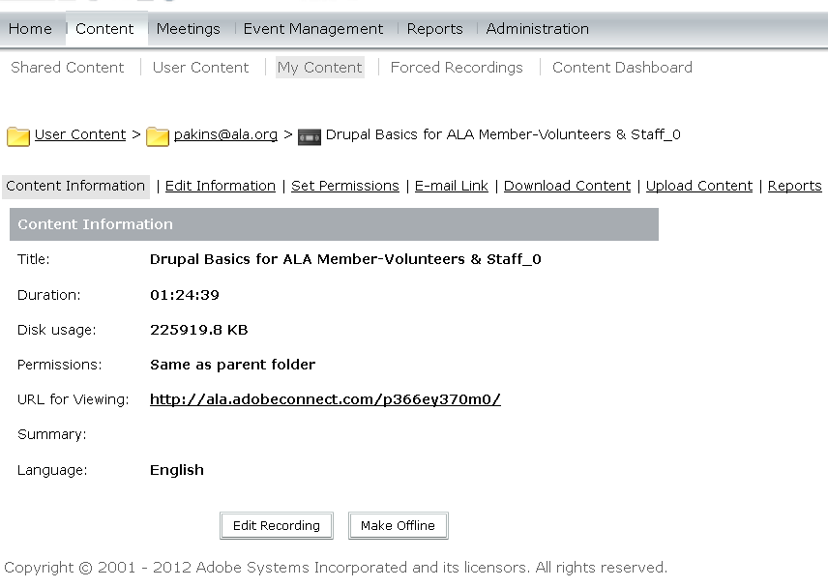
Manage Content
Event v. Mtg
Content & Reports
Setup Event
Invite & Register

Slide 35
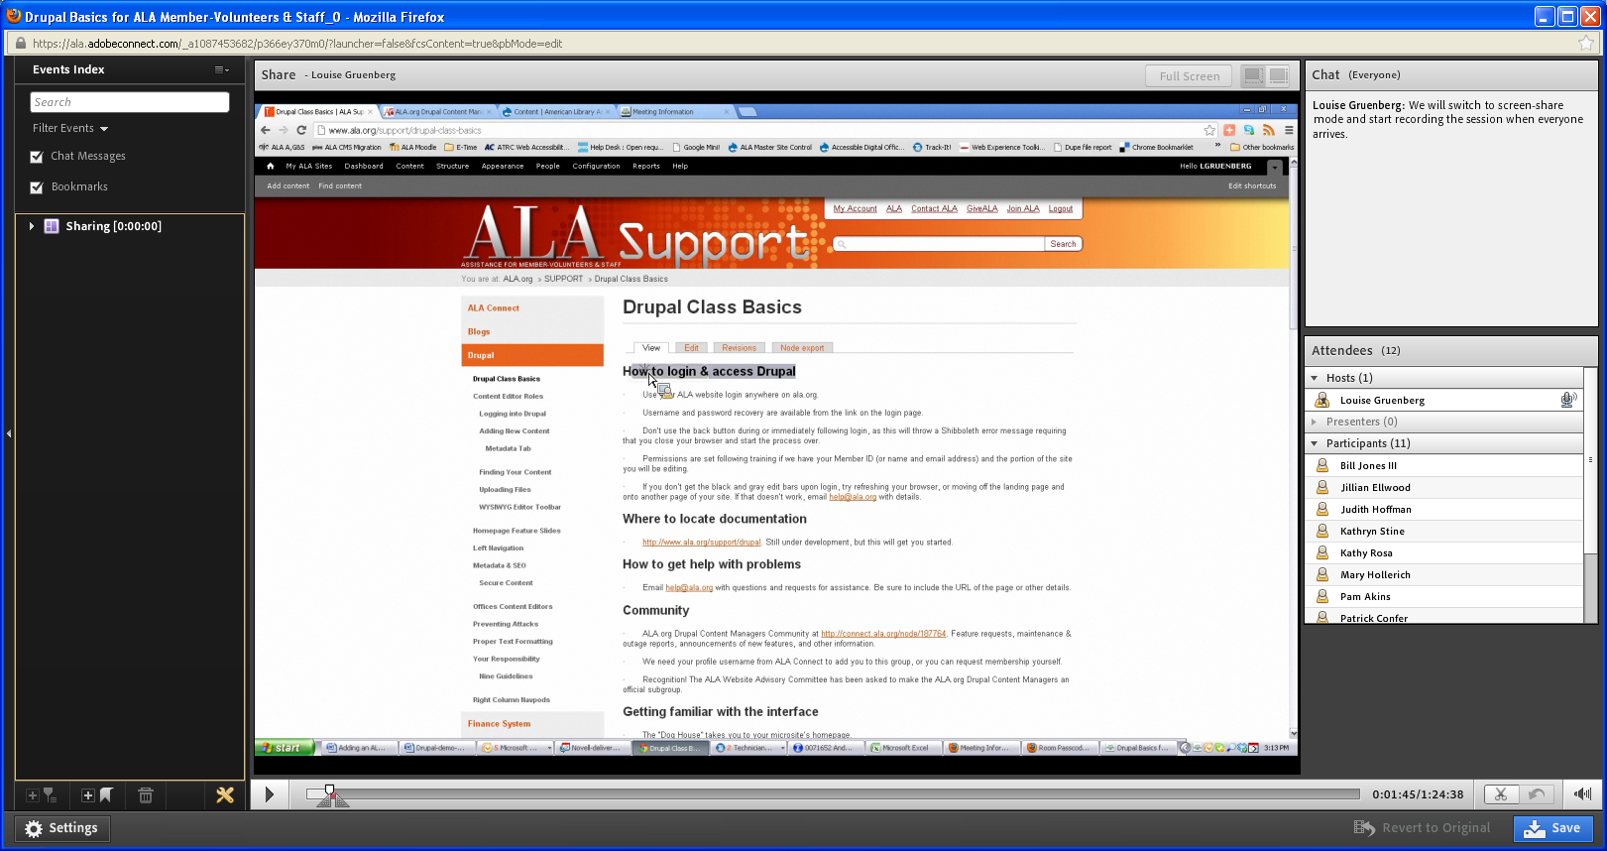
Edit Content
Event v. Mtg
Content & Reports
Setup Event
Invite & Register
You can bookmark, and cut pieces out of the recording, and more.

Slide 36
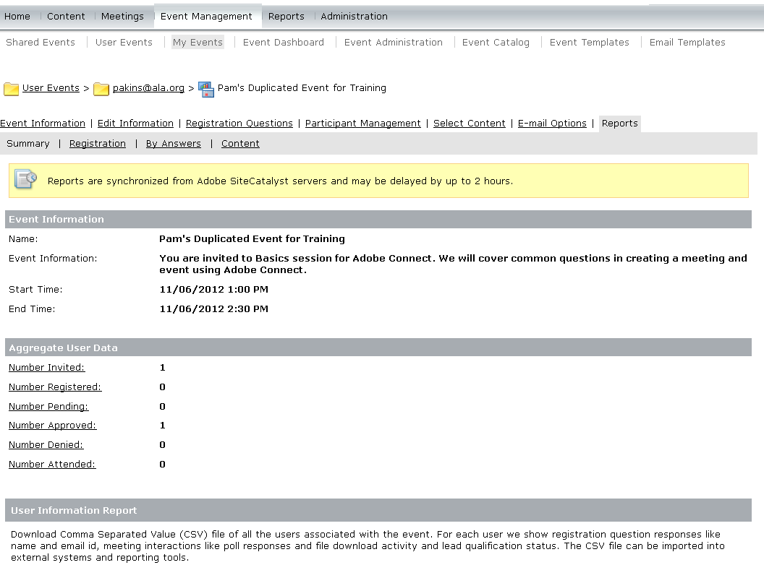
Content & Reports
Event v Meeting
Setup Event
Invite & Register
Content &Reports
Feedback & Fixes

Slide 37
Feedback & Fixes
Event v Meeting
Setup Event
Invite & Register
Manage Content
Run Reports
What is it you need to be capable of doing that you need from this class?
What questions do you still have about what you learned?
What other sessions/videos/resources can be created to support your capability in this tool?
http://www.connectusers.com/tutorials/2012/06/creating_an_event_in_adobe_connect_9/index.php

